Slide 1
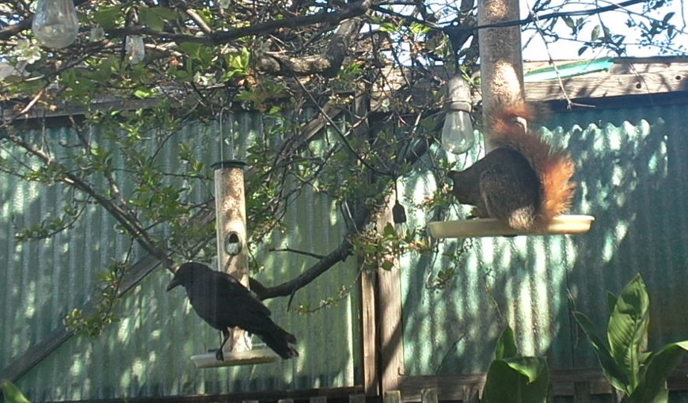

Machine Learning Image Based Pest Species Identification For Embedded Systems
Joshua Mehlman, SFSU ID #903035606, JMehlman@sfsu.edu
SFSU ENGR 859 Spring 2024

Slide 2
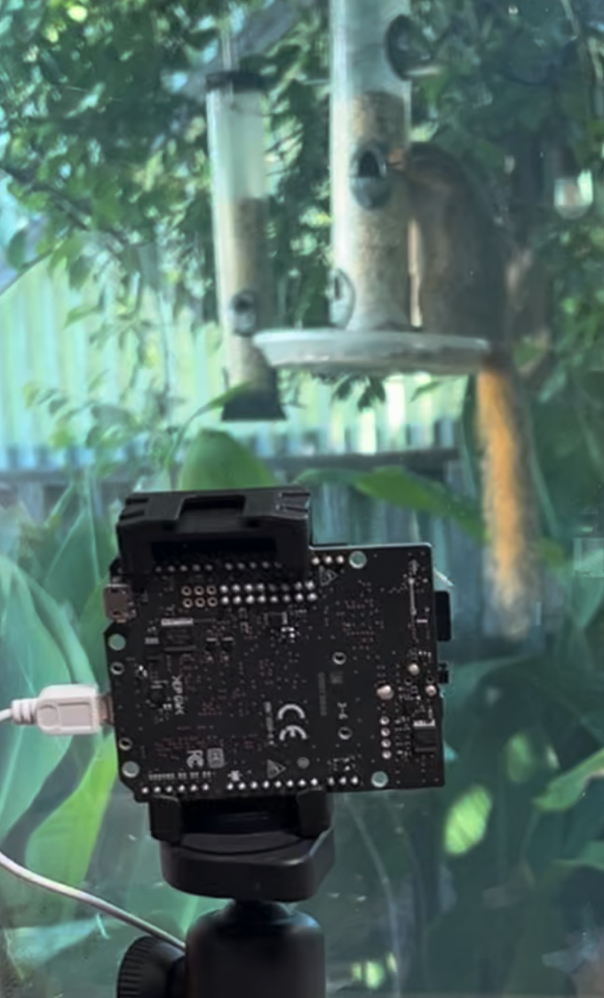
Pest Species Identification
Use Real Time Camera Data
The target species:
Eastern Fox Squirrel^{[1]}
Any bird
Running on Sony Spresense Microcontroller
Notes:
In our area the eastern fox squirrel is an invasive species, crowding out native squirrels,
and over competing with many birds for resources.
I am targeting bird food resources issues.
Running on a low cost, low power microcontroller enables a field deployable system.

Slide 3
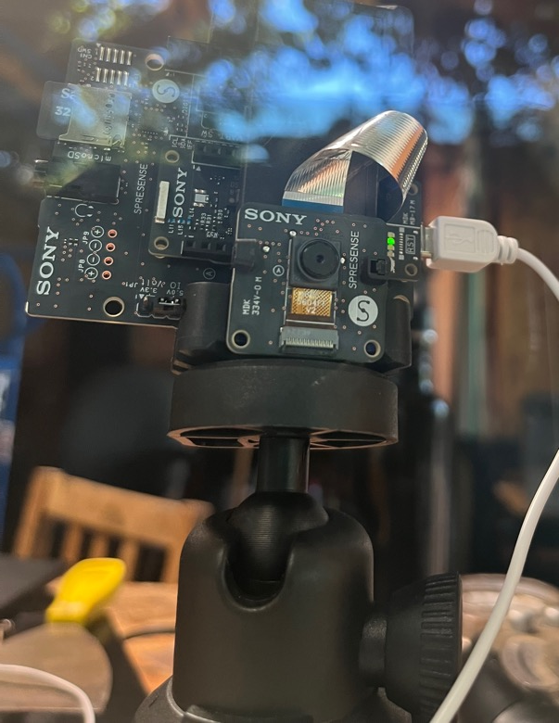
Hardware
Microcontroller^{[2]}:
ARM Cortex-M4F @ 156 MHz
SRAM: 1.5MB
Expansion Board
SD Memory Card Slot
Camera
Image Transfer: CMOS 8-Bit Parallel
Control interface: I2C
Sensor: 2,608x 1,960 (~5 M pixel)
Component | Model | Price
Single Board Computer | Sony Spresense CXD5602 | $65
Computer Storage Board | Sony Spresense Extension Board | $45
Memory Card | 32GB MicroSD | $20
Camera | Sony Spresense Camera (ISX012 Sensor) | $35
Notes:
The system is based around the Sony Spresense CXD5602
(The LED Status in this image is indicating no bird or squirrel)
Not a lot of computing power to work with here.
But the entire hardware stack is less than $200,
including the USB Cable and tripod… The zip-tie might push me over.

Slide 4
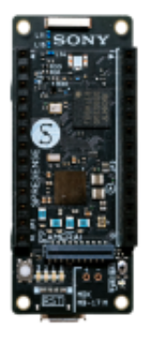
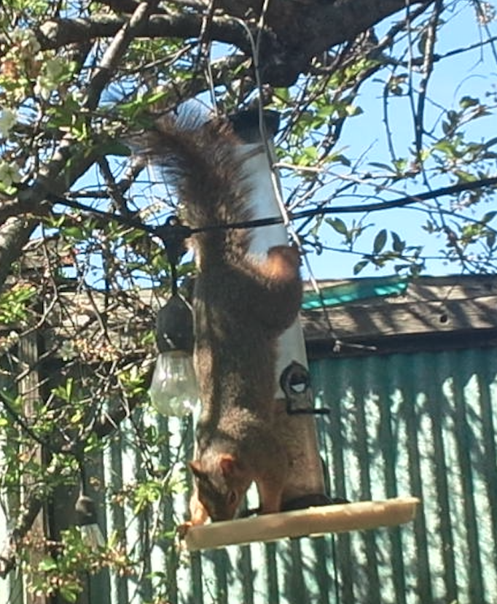
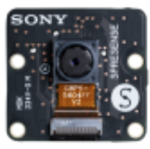
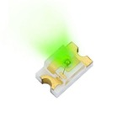
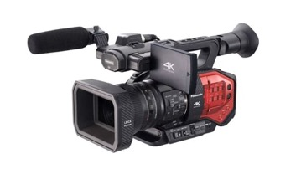
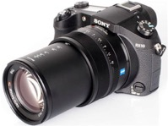
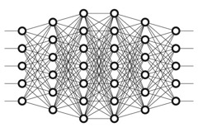
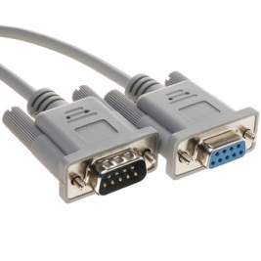
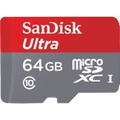
System Overview
LED1 | Inference
LED2 | Bird
LED2 | None
LED4 | Squirrel
Notes:
By the way, I have a LOT of pictures of squirrels!
Capture the image, there are 2 camera streams.
A video stream at that triggers a callback (5 Hz is as slow as it will go), set to BITMAP
A callable still image (set to JPEG)
Immediately take a still capture, but don’t save it yet.
Process the image and send to Model
Interpret results
Save Results: still Image and log to file
Light up indicator LEDs
Stream image OR log to serial

Slide 5
Pipeline/Flowchart
Capture Initial Dataset
Tag Dataset
Trigger of Video Image
Copy Images and Log from SD Card
Build Model
Capture Still Image
Tag Dataset
Train Model
Process Video Image
Export Model
TFLite-Micro
Run Model
Analyze Performance
Interpret Results
Light Up Indicator LED
Load Model
Notes:
The left is preliminary steps, the center is Realtime, with postprocessing to the right
The initial data set was captured as high of a resolution as possible (3MP, the camera is 5MP, but there is not enough memory for that and literally anything else.)
Further training data was captured during testing runs.
Each run was a single day.

Slide 6












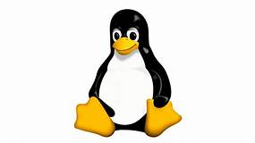

Toolkit/Tec Stack
Initial Data Set: Sony Spresense SDK in C under NUTTX
Image Tagging: Manual File Operations/Python Scripts OSX
Model Building/Training: Python, PyTorch
Model Deployment: TensorFlow Lite – Microcontroller, C
Runtime: Sony Spresense Arduino in C++, Logging to Linux
Data Analysis: Python
Image Stream Viewing: Serial → “Processing”, Java
Notes:
Fun fact: I wrote about 2,000 lines of code for this project.

Slide 7
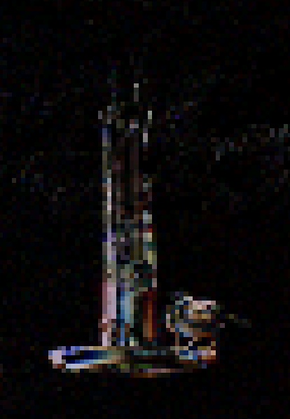
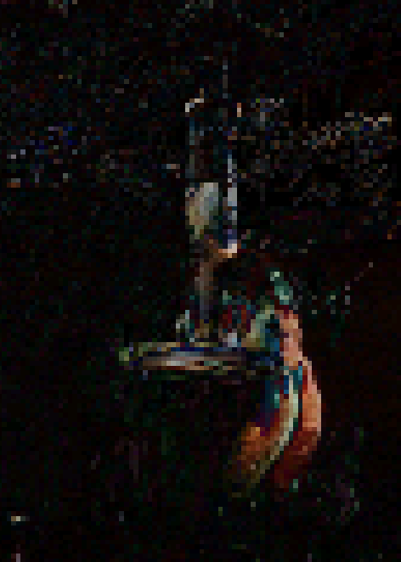
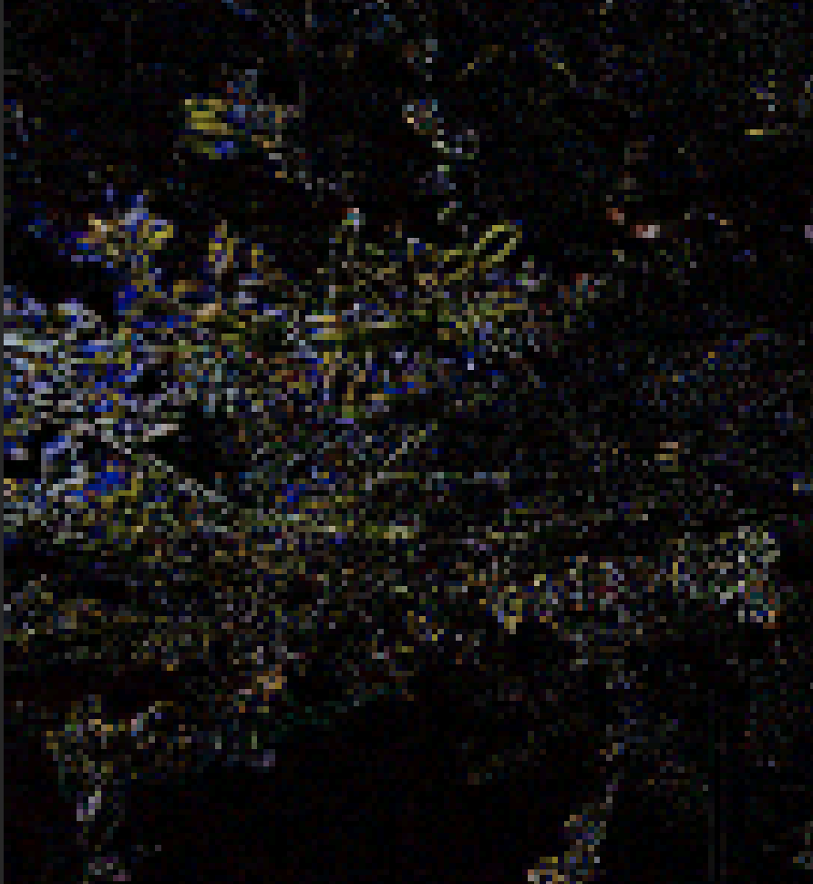
Gather Initial Image Set
Trigger On Motion to Capture Initial Dataset
Save the largest image we can as a JPEG
Subtract each BITMAP from the prior image^{[3]}
Subtract the R, G, and B from each prior to each image.
Give up and just capture on a timer
Notes:
The first idea was to trigger on motion to capture by subtracting the current image from the prior.
This did not work well. Too much branch motion, even if I ignored the Green channel
There are cool things you can do with image diffraction gratings and so on…
Tantalizingly close, Showing a bird, squirrel, and wind but…
Let’s just capture a lot of images and manually tag them.
I should probably use some sort of Machine Learning Algorithm to find the objects…

Slide 8
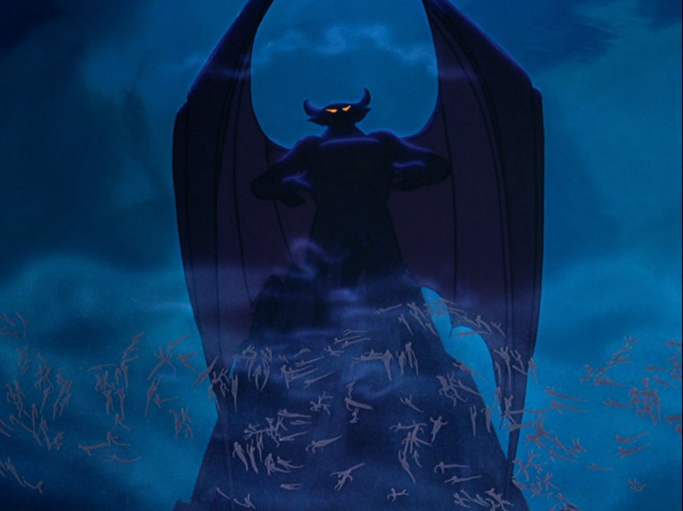

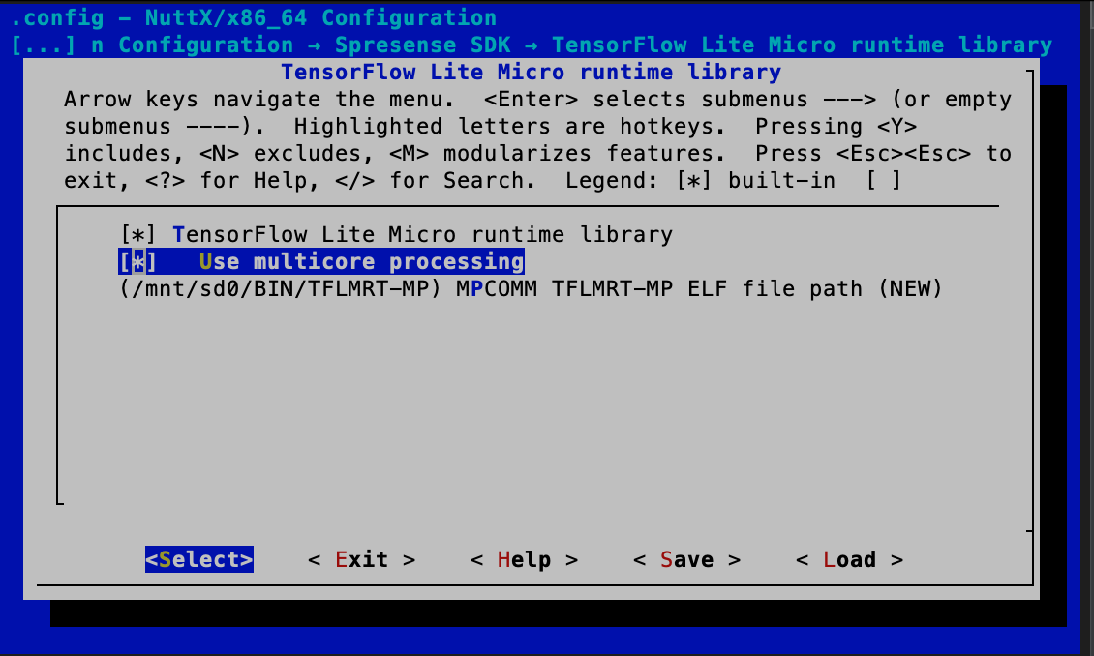
Get Working on Device
Start with super tiny modified LeNetV5 model to find out how large of image size we can handle.
Initial model size ~50kB
Still: 3M (At JPG Qual 70)
Video: 640x480
Notes:
The SDK has demons!
No, not daemons, demons!
There is a lot of potential there and a lot of very cool features, but its just to temperamental.
I would do a make, it would break.
Immediately do a make-clean, still broken.
Do another make-clean, and it would start working again.

Slide 9
Start Over With Arduino Library
Start with super tiny LeNetV5^{[4]} model to find out how large of image size we can handle.
Initial model size ~50kB
Still: 640x 480 (VGA)
Video: 320x240 (QVGA)
Smallest image size camera will do is: 96x96
Max model size:
Camera Memor:1.5 MB
Image Size at QVGA: 153.6kB
Notes:
There is no way a 96x96 image will work, its just too small, not worth even trying. But it’s the smallest image the camera library will do.
This is called “Foreshadowing”
The SDK was able to use larger images.
Also, had a much richer feature set, including image rotate and flip… I had to dismount, and remount the camera.

Slide 10
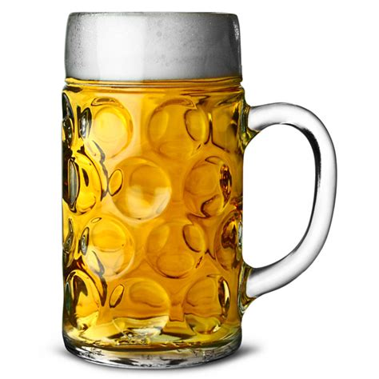
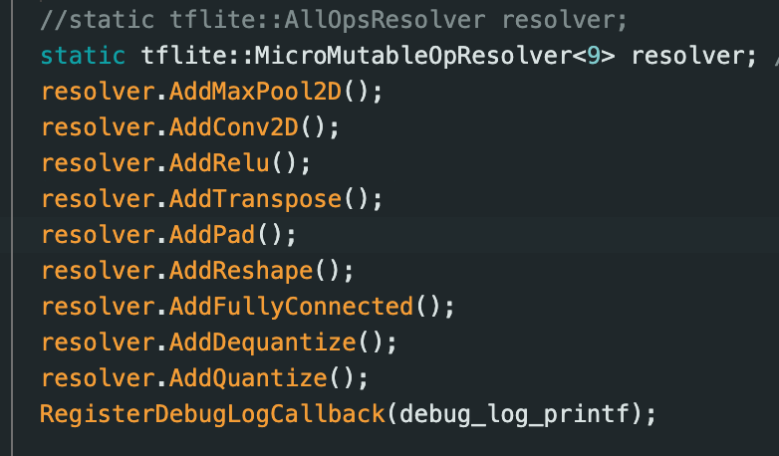
Model Wont Build
The Sony Spresense TFLite Build has no logging.
MIC to the rescue: The MIC Spresense TFLite Build Shows what is missing
Notes:
The Sony TFL Build had no logging
I didn’t even know I was using some of things missing.
Thanks Mr Lin, and the MIC lab

Slide 11
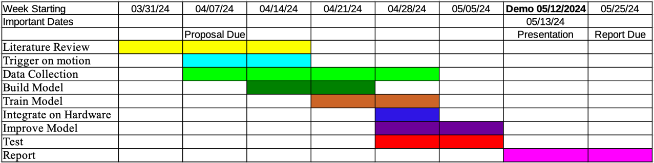
We have Pipeline! Now Build The Model
Next Steps:
Build Model
Capture Many More Images
Tag Images, Label and Box
Train Model
Export Model
Install on Device
Notes:
We have pipeline!
Just one small compiler warning…
Something about onnx-tensorflow being past end of life. I’m sure it unimportant (more foreshadowing)
All that’s left is <read from screen>
Crap!
we do not have enough time left for SSD or Yolo.
Just the image tagging alone will kill two full days. And we are looking at 2 weeks till demo!

Slide 12
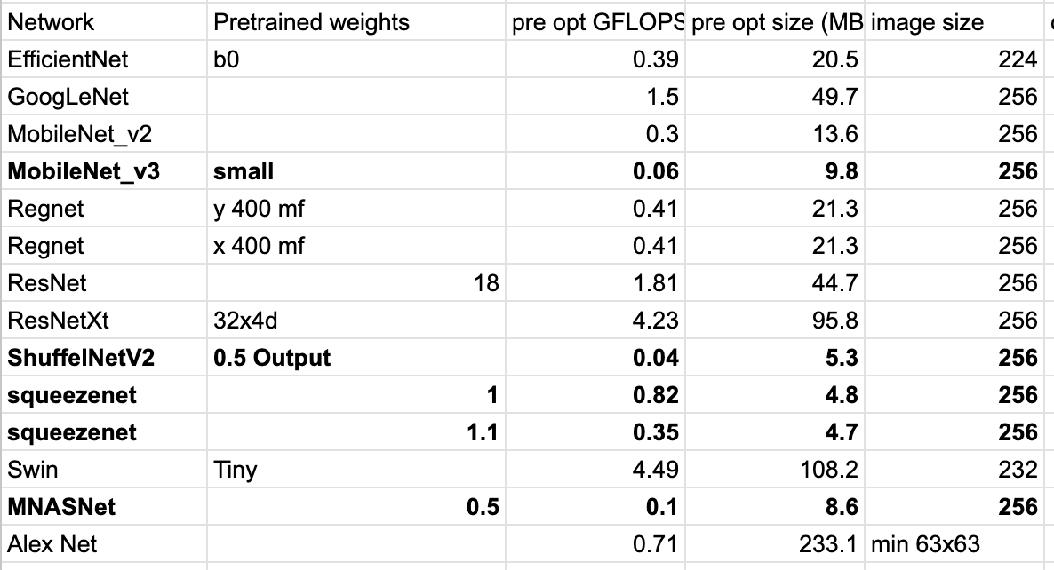
New Plan: Skip Object Detection Use Classifier Only
Start with a pretrained model, prune and quantization
Model List:
Size on 96x96:
AlexNet: 10MB
MobileNetV3: 6MB
Notes:
Ok, new plan Skip object detection an just use a classifier
Let’s take a look at the pre-trained models available.
I got less than 1MB of space to work with at a non-functional image size… Oh boy.
Let’s try MobileNet V3
6Meg / 4 for the quantization, will be 1.5 (ended up at 1.8)… I can prune in half… right?

Slide 13
How Big an Image Can We do
Model Size for full sized LeNetV5 with
Input: 2x96x96 = 480kB
Input: 2x160x120 = 1MB
Image size Max for 480kB model:
Video Stream: 320x240 (QVGA)
Stills: 320x240 (QVGA)
Remaining space: ~400kB…
Not enough for even 160x120 (QQVGA)
Notes:
Even just loading up the LeNet at QQVGA leaves only 400kB of space for incoming images

Slide 14
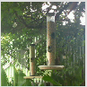
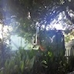
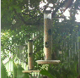
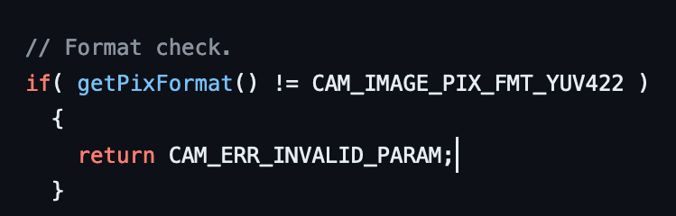
No Way It Will Work on Full Image
Have to go to 96x96 images to fit…
Crop, not scale
The Spresense Camera Arduino library Can only zoom with:
CAM_IMAGE_PIX_FMT_YUV422
Fun Fact: The only errors the camera seems to know is:
return CAM_ERR_INVALID_PARAM;
return CAM_ERR_NO_MEMORY;
Notes:
Well, crap!
400kB is not even enough to even capture 2x160x120 for the model input images!
And 96x96 is small, how small? That is too small.
How about a crop instead... Yeah, I think I can work with that.
I saw both of these errors quite a lot
But the camera front end is open. Start at the beginning and go over each error condition:
Gotcha!

Slide 15
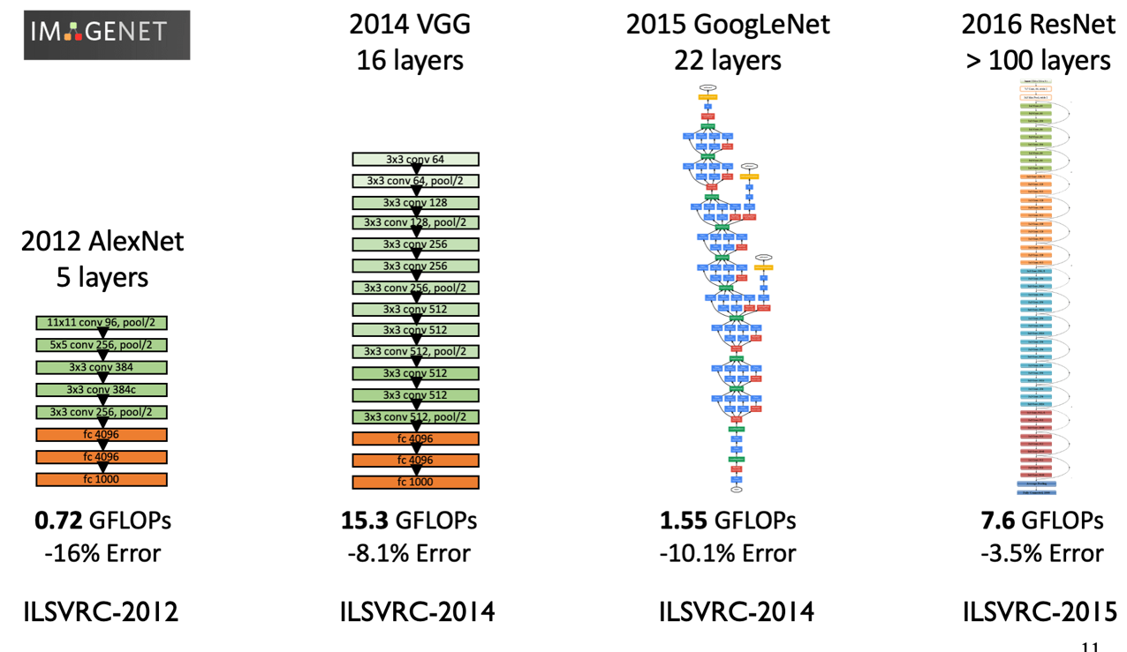
Pruned Pre-Trained Model
Failed
Failed
Failed
Failed
What am I missing???
Notes:
Before GoogLeNet, everything is linear, one step then the next.
This means the input of each layer is “easy” to trim based on the output from the prior layer and the input to the next
But after that our path is not so simple.
Layers bypass, re-enter, and skip over
Pruning that nonsense is way over my paygrade.
Thanks for the help on that Mr Lin

Slide 16
New Plan: Build and Train Model From Scratch
Continue using the LeNetV5
I have a good understanding of how to train
Got good results, and was fast on Fashion MNIST
Once that is working, move to the more complex MobilNetV1
Notes:
What's a 20 second inference time among friends?

Slide 17
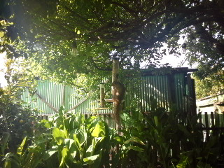
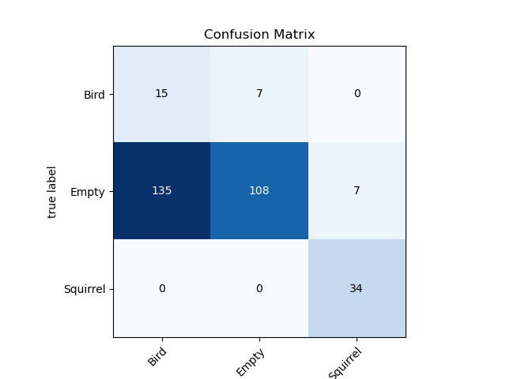
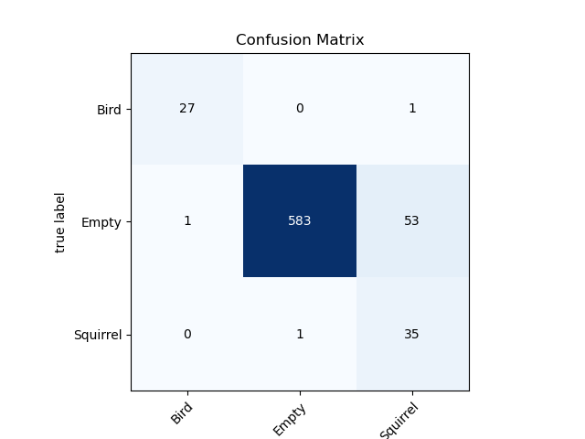
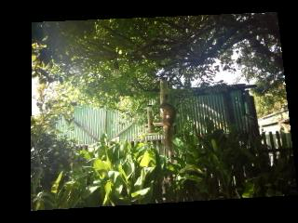
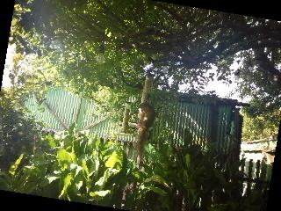
Not Enough Images (Too Many Empty)
Every Squirrel and Bird: Rotate, Permute
Train On Tagged Data
After Image Augmentation
Notes:
Left confusion matrix: Original training run… That is non-functional
Top: Original Image,
Center: permuted,
Bottom: rotated
Right confusion matrix: After augmentation
Not great, but actually not terrible!
I also seem to have lost some images somewhere along the line.

Slide 18
Run Real Time (AKA: And My Troubles Began)
Once the model was installed the results were the same every image
Swap the bit order in the training images
Variation, but nonsense results
Run the TFLite Model Under Python on Saved Images
Gives good results: Replace Onxx-Tensorflow with onnx2tf
Run on board: Every image the same
Increase the Arena size,
Don’t let the camera run time cut into its next image.
Variation!!
Put the model into play the next morning: Every image the same results.
Notes:
If I changed the model training, I would get a different result.. But still the same answer for every image that came in.
I tried everything
Mr Lin suggested running the TFLite model in python on my desktop.
The model is no good! Same results at every image.
Mr Lin suggested changing out onnx-tensorflow with onnx2tf… Hay, remember that compiler warning way back when?
What was it: Something about onnx-tensorflow being deprecated and no longer supported?
Changing Converter out… Non trivial task. But at least I got to write more for loops
Works on Python.... But not on the board
This makes no sense!
Everything is the same, what could be different.
Woke up in the middle of the night with the realization that there are 2 things different:
The hardware (Do I have a non reported memory issue? C can be trixy that way)
The camera. My inference time is WAY over the minimum 5 Hz. Is it somehow partially overwriting the buffer?
Put the changes into play got variation. At 3AM in a dark room.
… the next morning no joy. Same answer every image.

Slide 19
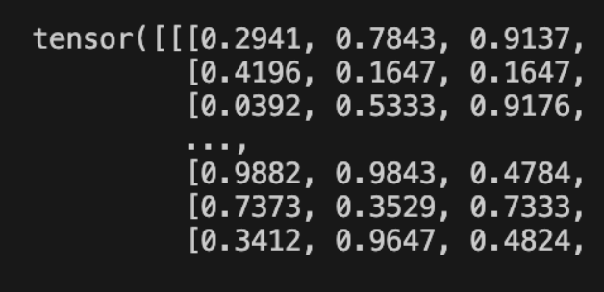
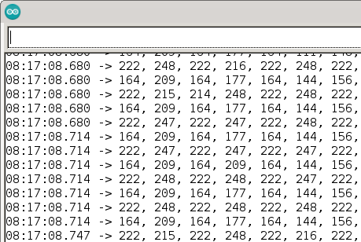
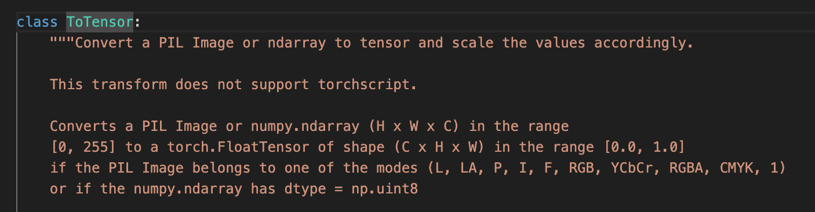
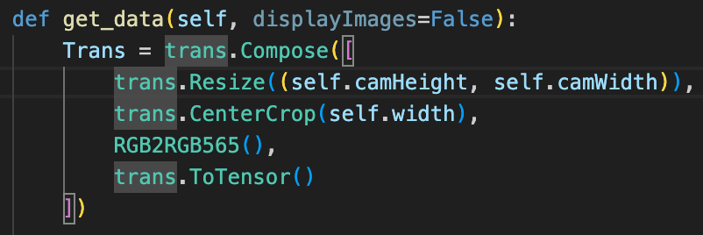
At night it works, but in the daytime it doesn’t
Image Directly From: torchvision.transforms.ToTensor
Image Directly From Camera
Notes:
Low light gave me the variation of results!
Crazy low values work… The image intensity is too high!!
Image on the board: 0 – 255, Image from DataLoader 0.0 to 1.0
The torchvision.transforms.ToTensor is normalizing to 1!

Slide 20

… Still Every Image the Same Results
Still no joy. ARRRRGH!
Go for a run, clear my head
When I get back Start from the begining
Swap the byte order on the training data
Notes:
This has to work!! No no no
Run the pipeline from the beginning
Write down every step.
Change the filenames for the model as I go.
No mistakes
Different Results!! … But non-sensical
Swap the byte order RGB2BGR
It works!!!

Slide 21
It Works!
Switch to a faster MobileNetV5
Get model small enough to fit on Spresense
Iterate on the training and Hyperparameters
Train for real.
Gather All the images.
Set the model to save when it has a squirrel or a bird
Manually tag, using false positives in the “Empty” set
Analyze data
Write Presentation
Practice Presentation

Slide 22

MobileNetV1
Size:
PyTorch Size: 71.2MB
TfLite: 18MB
Max Size for Spresense: << 1 MB
Remaining Time Before Demo is Due: 4 Days
Notes:
Ok, lets see where we are with MobilNetV1
That is a long way to go before we can fit it on the board

Slide 23
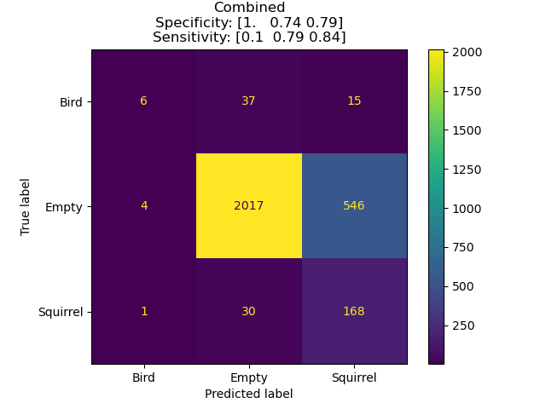
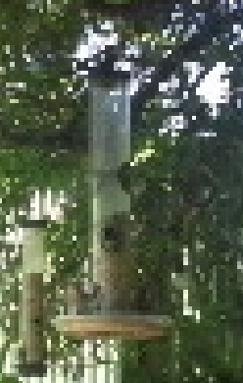
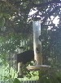
New Plan: Run With What I Have
Run on real-time:
Incorrectly Predicted
Image of a Bird
(Predicted Empty)
Correctly Predicted
Image of a Bird
Notes:
Oh, and a storm came in and re-arranged my tree.
The performance is actually not terrible! Ok, its bad, but not terrible. Ok, maybe its terrible. But it IS functional!
Well, for empty vs. squirrel anyway. Birds, not so much.
Looking at some of the bird data I think I know why:
There seems to be a theme here with the correct birds, and the incorrect birds…

Slide 24








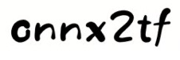






PyTorch → TF Lite - Microcontroller
TensorFlow Lite
to C Header
Build Train and
Save PyTorch Model
PyTorch to ONNX
ONNX to
TensorFlow
TensorFlow to
TensorFlow Lite
Birds
and
Squirrels
Image Mean
STD
Image
Shape
Representative
Dataset For
Quantization
Build On
Microcontroller
Notes:
But at least The model conversion path is finally nailed down
Nice and simple!

Slide 25
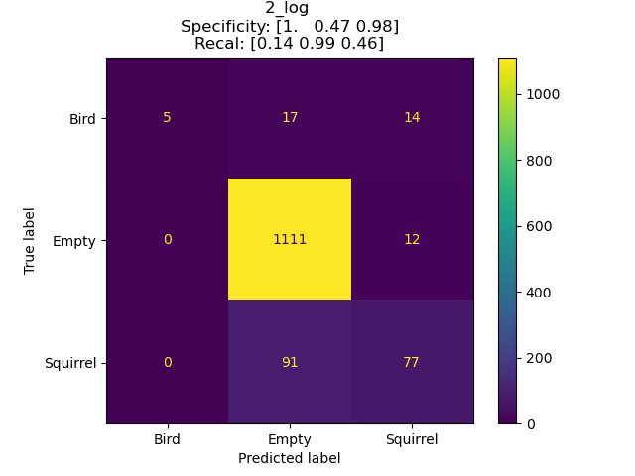
Re-Train on Larger Dataset
Before Re-Training
Run After Re-Training
Notes:
Much better for empty… much worse for squirrel.
Still trash with birds.
The jpeg compression at QVGA is killing me on training images.
I just need to capture more training data a high rez, and focus on larger birds
Does it work well? No
Does it work? Absolutely.
At this point, I am calling that a win!

Slide 26
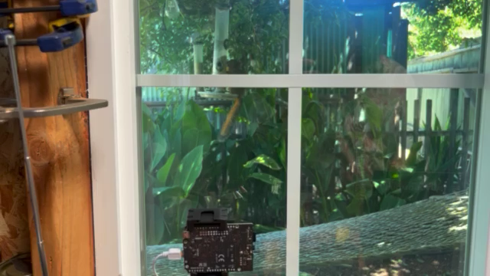
Notes:
Lets take a look at the system in action

Slide 27
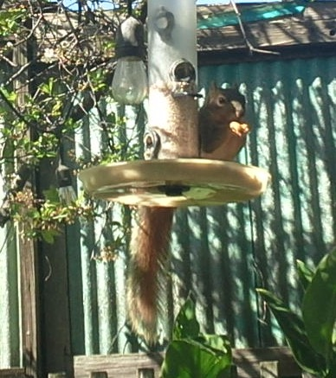
References
Krause, S. K., Kelt, D. A., & Van Vuren, D. H. (2010). Invasion, damage, and control options for eastern fox squirrels. In Proceedings of the Vertebrate Pest Conference (Vol. 24, No. 24).
https://developer.sony.com/spresense/product-specifications
Singla, N. (2014). Motion detection based on frame difference method. International Journal of Information & Computation Technology, 4(15), 1559-1565.
LeCun, Y., Boser, B., Denker, J. S., Henderson, D., Howard, R. E., Hubbard, W., & Jackel, L. D. (1989). Backpropagation applied to handwritten zip code recognition. Neural computation, 1(4), 541-551.
Notes:
Thank you,
Oh, and here is one more picture of an Eastern Fox Squirrel.
By far the cutest invasive in my yard.
Questions, comments, concerns?

